Slide 1
Section 6.3 Special Triangles
© Copyright all rights reserved to Homework depot: www.BCMath.ca

Slide 2
i) What are Special Triangles?
There are two types of special triangles:
30°, 60°, 90° triangle (Equilateral Triangle) and
45°, 45°, 90° triangle (Isosceles-Right Triangle)
Equilateral Triangle
Isosceles-Right Triangle
All sides and angles are equal
Two sides are equal and one angle
Is equal to 90°
Cut it in half
Use Pythagorean Thm. to find the hypotenuse of the triangle
Use Pythagorean Thm. to find the height of the triangle
Isoceles → 2 equal angles
© Copyright all rights reserved to Homework depot: www.BCMath.ca

Slide 3
Special triangles can be used to find the exact value of sine/ cosine/tangent of basic angles like: 30°, 45°, 60°, and 90°
Rather than obtaining a decimal representation, we get the exact value as a fraction using special triangles
© Copyright all rights reserved to Homework depot: www.BCMath.ca

Slide 4
Ex: Use the special triangles to determine the exact value of each angle:
© Copyright all rights reserved to Homework depot: www.BCMath.ca

Slide 5
When one side of a special triangle is given, the lengths of the other two sides can be found without calculations
Simply use the ratios of the triangle to find the lengths
Ex: Find the lengths of the missing sides
Correspond the sides with the special triangle
Find “k”

Slide 6
Ex: Find the missing lengths:
1. Special Triangle
2. Isosceles Triangle
© Copyright all rights reserved to Homework depot: www.BCMath.ca

Slide 7
Given the following trapezoid, find the area :

Slide 8
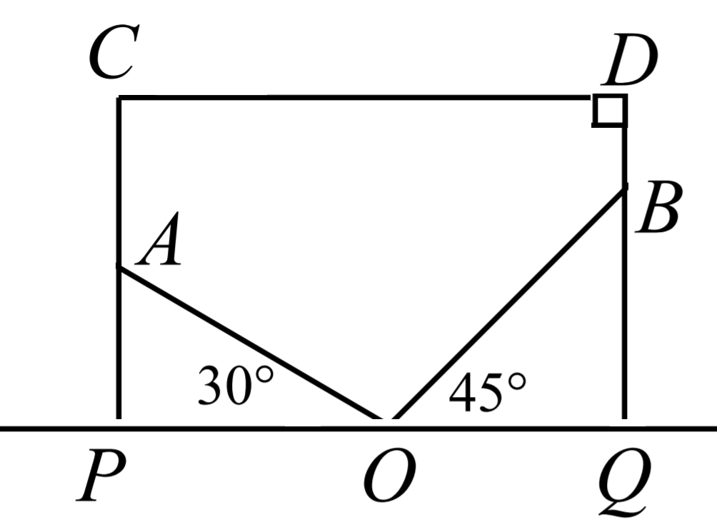

Slide 9
A circle is inscribed inside an equilateral triangle where it is tangent to three sides. Another equilateral triangle is inscribed inside the circle. What is the ratio of the Bigger Triangle’s Area to the Smaller Triangle’s area

Slide 10
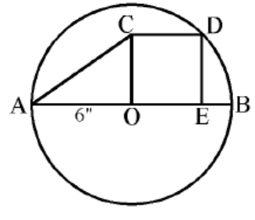

Slide 11
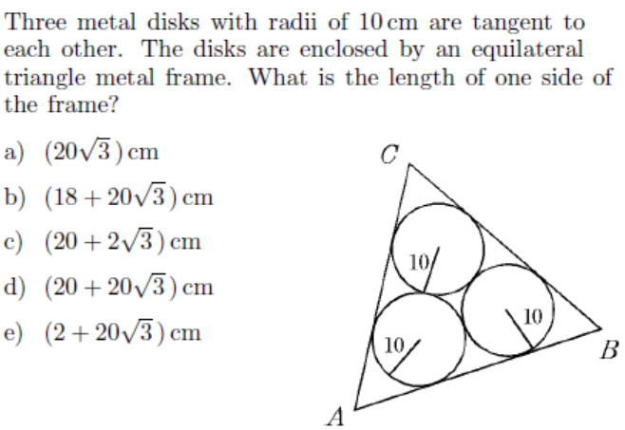

Slide 12
Solving Problems with Special Triangles
Many math problems can be easily solved using special triangles
Often there’s an equilateral triangle or an angle of 30, 45 or 60 degrees
Ex: Given that ABCD is a square with side length 4cm, BCE is an equilateral triangle, what is the length of DF?
Draw a line from “F” to the bottom, to create a 45-45-90 and 30-60-90 triangle
Make “x” the side length of the left triangle
Since it’s a 45-45-90 triangle, the red line is also “x”
The base of the right triangle is 4 – x
Since it’s a 30-60-90 triangle, the base is also
Once we have “x”, we can find “DF”
Solve for “x”

Slide 13
The first step is to draw the triangle
Isosceles Triangle!!
Draw lines to construct a special triangle
Area of ACT is
Find the lengths the sides
Area of ATB is
The total area will be:
Do the same thing in the other triangle

Slide 14
2nd Solution:
Draw a line from “C” to the bottom
Now you have two special triangles!
The area of the entire triangle will be:

